Slide 1
WHO WANTS TO BE A MILLIONAIRE?

Slide 2



WHO WANTS TO BE A MILLIONAIRE?

Slide 3



WHAT IS VALID FOR THE SINGLETON DESIGN PATTERN? (SELECT ALL THAT APPLY)
Its name makes communication between designers more efficient
Ensures a class only has one instance, and provides a global point of access to it
There are various different ways of implementing the singleton pattern
Clients should access a Singleton instance solely through Singleton::GetInstance( ) operation
A special hook in the form of method “protected Object readResolve()” needs to be implemented in order to achieve a proper deserialization
All of the above

Slide 4
WHAT IS VALID FOR THE SINGLETON DESIGN PATTERN? (SELECT ALL THAT APPLY)
Its name makes communication between designers more efficient
Ensures a class only has one instance, and provides a global point of access to it
There are various different ways of implementing the singleton pattern
Clients should access a Singleton instance solely through Singleton::GetInstance( ) operation
A special hook in the form of method “protected Object readResolve()” needs to be implemented in order to achieve a proper deserialization
All of the above

Slide 5
WHAT IS NOT VALID FOR THE SINGLETON DESIGN PATTERN? (SELECT ONE OPTION)
Eager Initialization
Lazy Initialization
Abstract Strategy
Bill Pugh’s Solution
Double-Checked Locking
Static block Initialization
Enum Singleton

Slide 6
WHAT IS NOT VALID FOR THE SINGLETON DESIGN PATTERN? (SELECT ONE OPTION)
Eager Initialization
Lazy Initialization
Abstract Strategy
Bill Pugh’s Solution
Double-Checked Locking
Static block Initialization
Enum Singleton

Slide 7
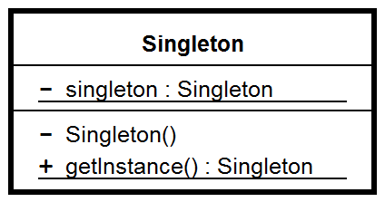
IS THE FOLLOWING SINGLETON UML CLASS DIAGRAM VALID?
YES
NO

Slide 8
IS THE FOLLOWING SINGLETON UML CLASS DIAGRAM VALID?
YES
NO

